Slide 1
CPRG 200
Day 6

Slide 2
Day 5 Agenda
More advances class concepts – indexers, events, function delegates, operator overloading
Class Inheritance
Polymorphism
Abstract class
Reading:
Chapters13 - 14

Slide 3
The code for a simple ProductList class

Slide 4
The code for a simple ProductList class (cont.)

Slide 5
The ProductList class

Slide 6
The ProductList class (cont.)

Slide 7
The ProductList class (cont.)

Slide 8
An indexer that uses an integer as an index

Slide 9
A read-only indexer that uses a string as an index

Slide 10
Code that uses these indexers

Slide 11
An indexer that checks the range and throws an argument exception

Slide 12
An indexer that validates data and throws an argument exception

Slide 13
Three argument exceptions

Slide 14
Code Demo
Application from Chapter 13 – Product Maintenance – let’s take a look at how indexers are used

Slide 15
Delegates
A delegate is a type that refers to methods with specific signature (return type and parameters list)

Slide 16
Code in a form that uses the delegate

Slide 17
Code in a form that uses the delegate (cont.)

Slide 18
The syntax for declaring an event

Slide 19
Code in a form that wires the event handler and handles the event

Slide 20
How to create a delegate using an anonymous method

Slide 21
How wire an event using an anonymous method

Slide 22
Back to the Code Demo
Application from Chapter 13 – Product Maintenance
Let’s see how delegate and event are used

Slide 23
Part of a ProductList class that overloads the + operator

Slide 24
Code that uses the + operator of the ProductList class

Slide 25
The syntax for overloading unary operators

Slide 26
The Equals method of the Object class

Slide 27
Code that uses an expression-bodied operator

Slide 28
Code that overloads the == operator for a Product class

Slide 29
Code that overloads the == operator for a Product class (cont.)

Slide 30
Code that uses the == operator of the Product class

Slide 31
Once more Code Demo
Application from Chapter 13 – Product Maintenance
Let’s look at an example of operator overloading

Slide 32
Introduction to Inheritance
A form of software reuse
Defining new classes by extending existing classes
Used when the new class captures a concept that “refines” the concept captured by an existing class
New class “inherits” members of the existing class

Slide 33
Examples of Inheritance
Implements generalization relationship: “is-a” (“is-a-special-case-of”) relationship
Circle is a 2DShape
Rectangle is a 2DShape
SavingsAccount is an Account
FullTimeEmployee is an Employee

Slide 34
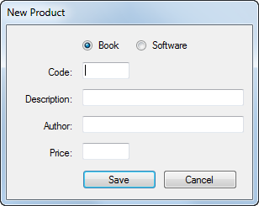
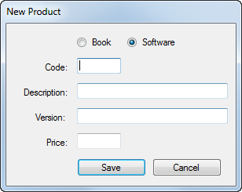

Slide 35
How Inheritance Works

Slide 36
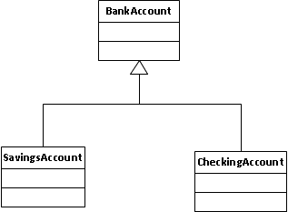
UML Notation
Base class
Generalization relationship
Derived classes

Slide 37
Base Class and Derived Classes
The existing class from which the new class is derived is called a base class
A derived class is the new class that extends the existing base class
Base class is “more general”, and derived classes are “more specific”

Slide 38
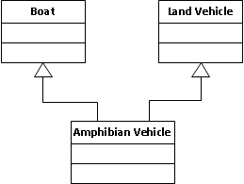
Single Inheritance
One base can have multiple derived classes, but
A class can directly inherit only from one base class
In C# there is no multiple inheritance
(C++ allowed it)

Slide 39
Inheritance Syntax
In the class header of the derived class add colon and base class name:
public class SavingsAccount : Account
Derived class inherits data and methods of the base class
Declare only added data members (do not declare inherited data )
Define only added methods (do not repeat methods inherited from the base class that do not need change)

Slide 40
Adding More Members
Derived class not only inherits members of its base class, but can also define its own specific members
Example:
class PermanentEmployee: Employee
{
// additional data member
private int rrspPercent;
// …
}

Slide 41
Constructor in the Derived Class
Needs parameters for both sets of data: inherited from the base class as well as added data
Passes values intended for the data inherited from the base class to base class constructor
public PermanentEmployee
(string n, double h, double r, int p)
: base(n, h, r)
{
rrspPercent = p;
}

Slide 42
Protected Members
Derived class inherits all members from the base class, but cannot directly access private inherited data
Can access private data inherited from the base class only through the base class methods
Alternative solution: in the base class, make data that the derived class needs to access protected members of the base class

Slide 43
Private vs. Protected vs. Public

Slide 44
Overriding Methods
Derived class may override (redefine) methods inherited from the base class
Override means provide own version of the method
Base class must allow for overriding
Both overridden method (in the base class) and overriding method (in the derived class) must have the same signature (return types and parameter lists)

Slide 45
Syntax for Overriding
Use one of the following keywords both in the base class and the derived class
override
virtual
abstract
Let’s analyze code example from the textbook: Product Maintenance from Chapter 14

Slide 48
To allow overriding

Slide 49
Book inherits from Product
Passes values to base class constructor
Constructor of the derived class

Slide 50
Overrides method from the base class

Slide 51
Another class derived from Product

Slide 53
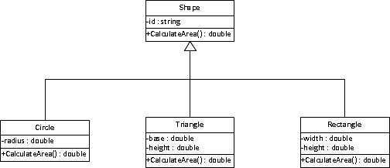
Class Inheritance Hierarchy

Slide 54
Programming Exercise
Let’s code the classes from the previous slide
For simplicity, let’s make it a console application; in the main just create one object of each kind, calculate area and display it

Slide 55
Polymorphism
The same code executes differently, depending on the actual object’s type
In our programming exercise, make an array or list of references type Shape
Add objects of types Circle, Triangle and Rectangle to the array (or list)
Run a for loop that calculates area of each object and displays the results

Slide 56
Abstract Method and Abstract Class
An abstract method is a method without body
Must use keyword abstract in the header
For example:
public abstract double CalculateArea();
Public properties can be abstract, too
An abstract class is a class that has at least one abstract method or property
Also use keyword abstract in the header
For example:
public abstract class Shape
{ //…
}

Slide 57
Using Abstract Class
An abstract class cannot be instantiated (it’s definition is not complete)
It can only be used as a base for inheritance
Allows avoiding “artificial” definitions of concepts that do not have a clear meaning
For example: What is area of a Shape2D? We do not know until we know what kind of shape it is

Slide 58
This Is It
This is it for today
Reminder: Lab 2 is due at 8 a.m. on the first day of the second part of the course (in about a week)

